Slide 1
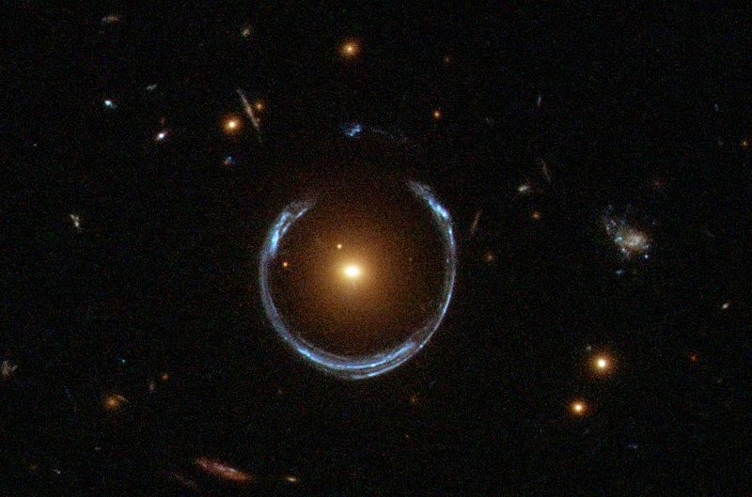
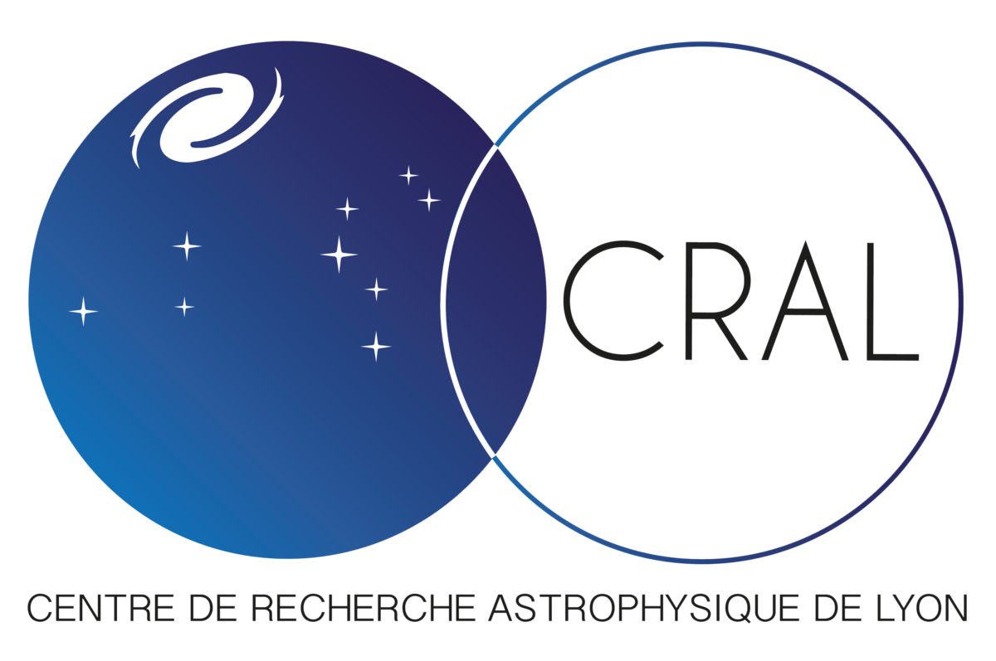

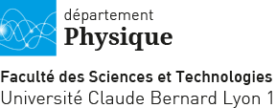
Numerical project : Lenstool
M2 astrophysics - Rocher Antoine
Supervised by Richard JOHAN

Slide 2

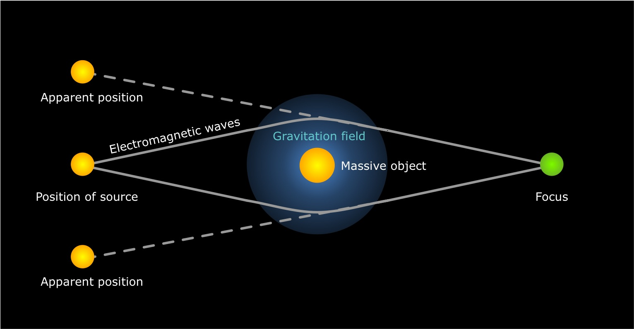
Gravitational Lensing effect
Source behind a massive object
Massive object deflects light rays
Observer sees several images
2

Slide 3
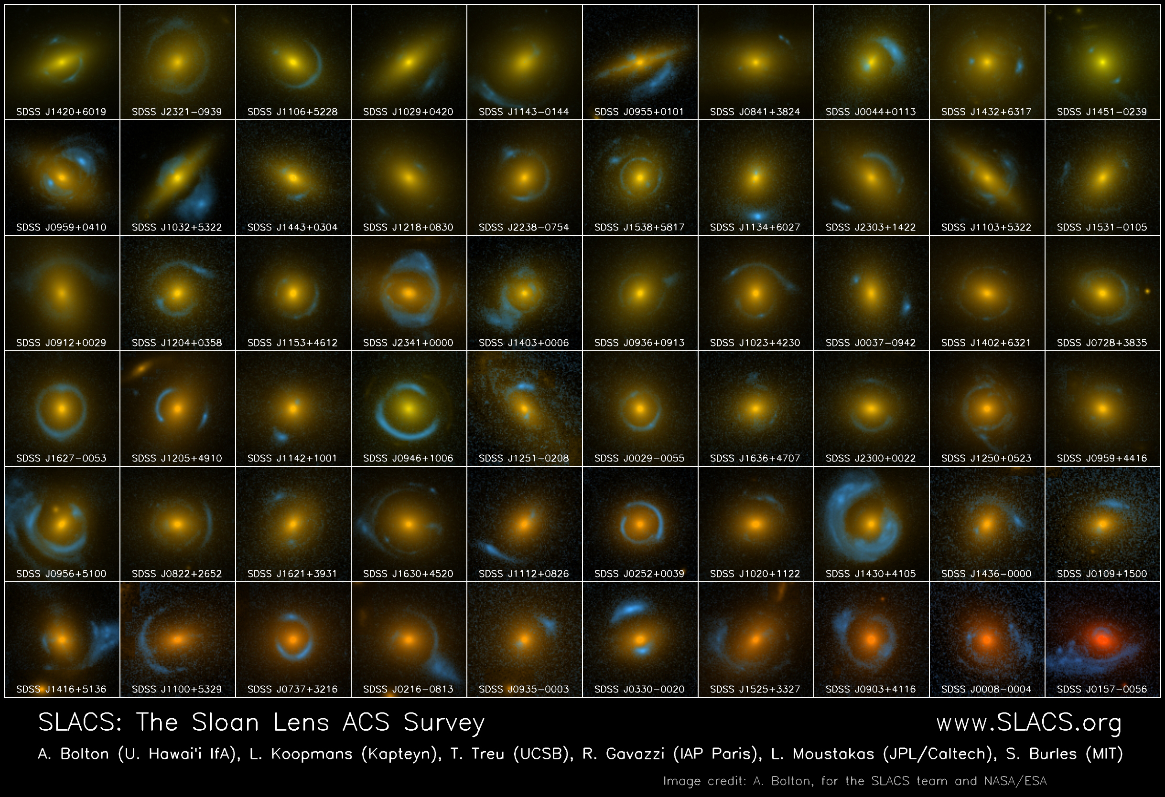
3

Slide 4
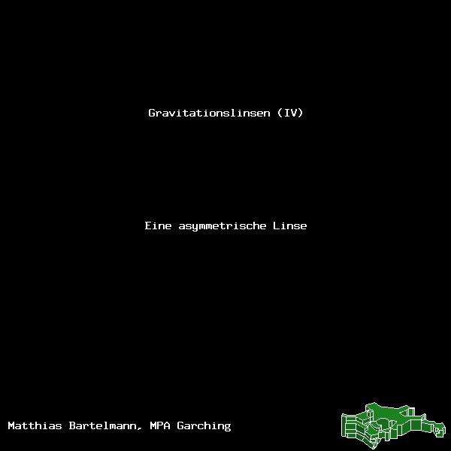
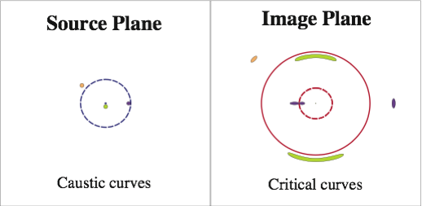
Gravitational lensing
4

Slide 5
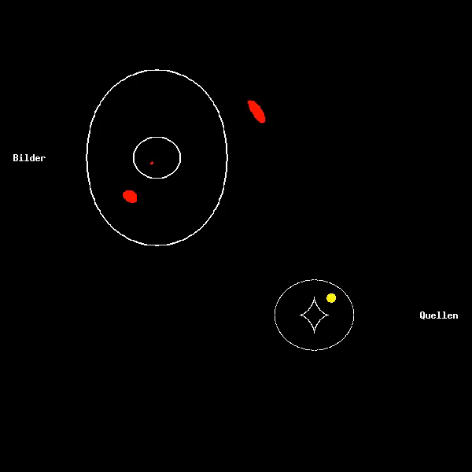
Gravitational lensing
5

Slide 6
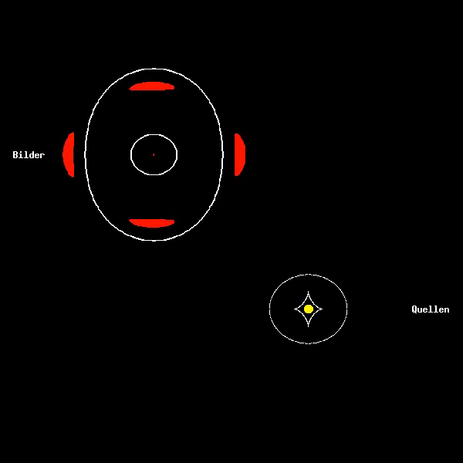
Gravitational lensing
6

Slide 7
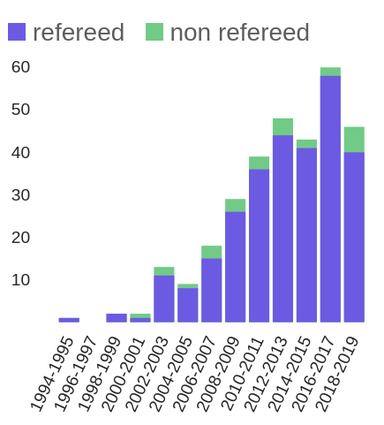
Lenstool: informations
Gravitational lensing simulation program
Created by J.P. Kneib (1993)
Public, open source, multi developers
French collaboration : Toulouse, Marseille, Lyon
Used by about 10 research teams around the world
7

Slide 8
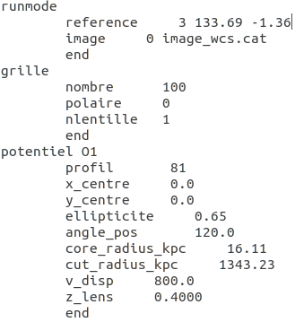
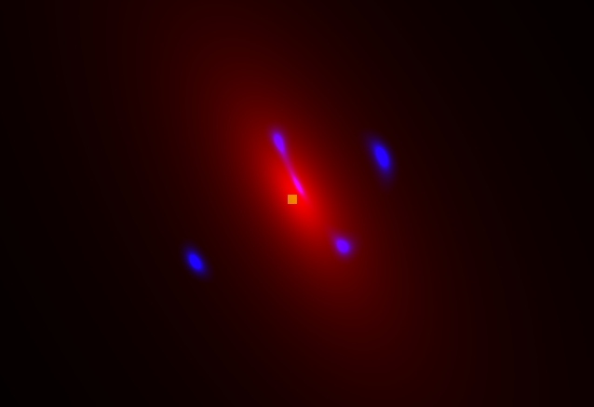
Lenstool: Running
INPUT : source / image positions
+ lens parameters
OUTPUT : All images and source(s) positions
Red: Potential
Blue: Images
Yellow: Source
8

Slide 9

Lenstool: Model
Caustic lines
Red: Potential
Blue: Images
Yellow: Source
9

Slide 10
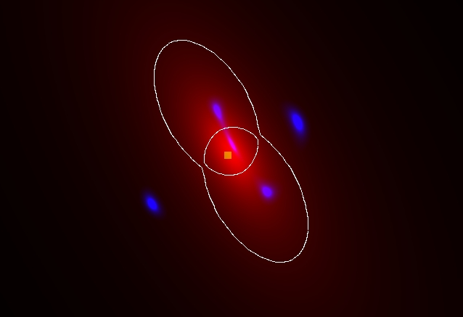
Lenstool: Model
Critical lines
Red: Potential
Blue: Images
Yellow: Source
10

Slide 11

Lenstool: Model
Red: Potential
Blue: Images
Yellow: Source
Critical lines
Caustic lines
11

Slide 12
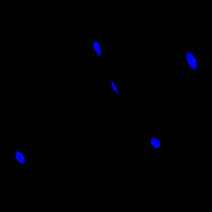
Lenstool: Shear
Model + vertical shear strength up to γ=0.2
Environment effects create a deformation on images
Modelisation by a shear in the image
The Shear is described by a strength γ and an angle α
Objective Find the images with no shear
α​=90°
12

Slide 13
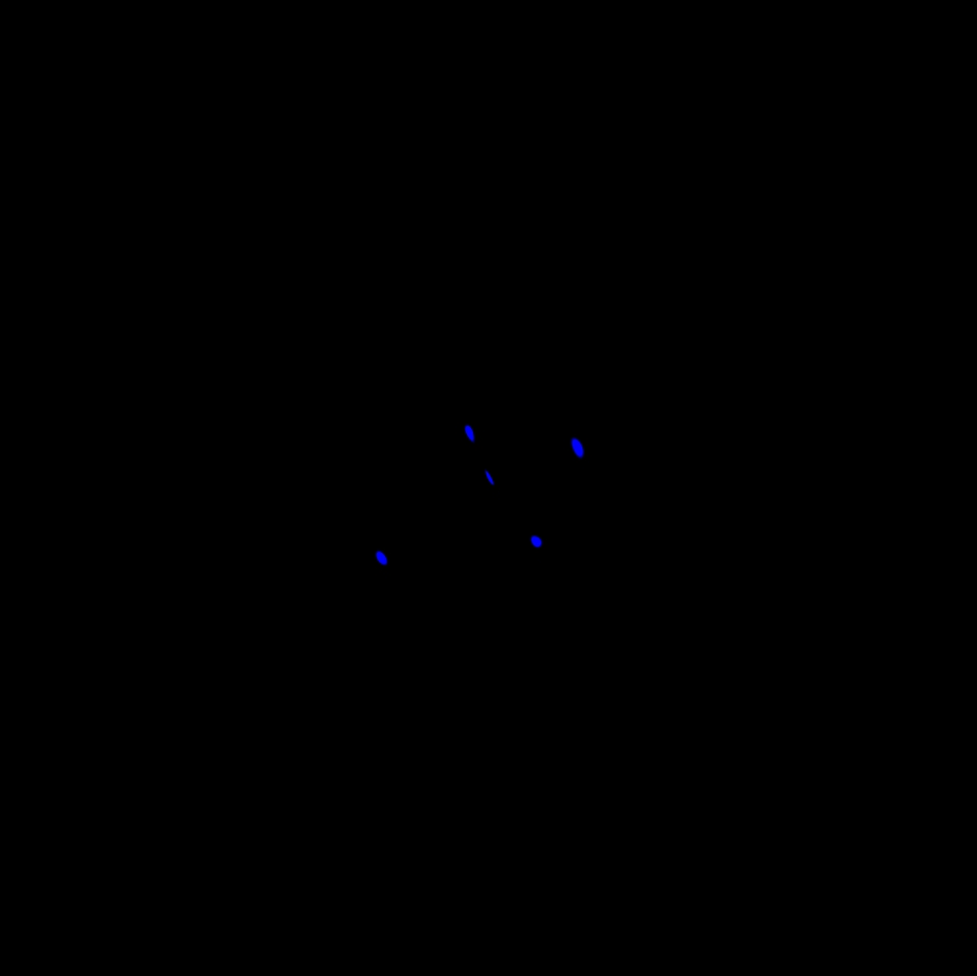
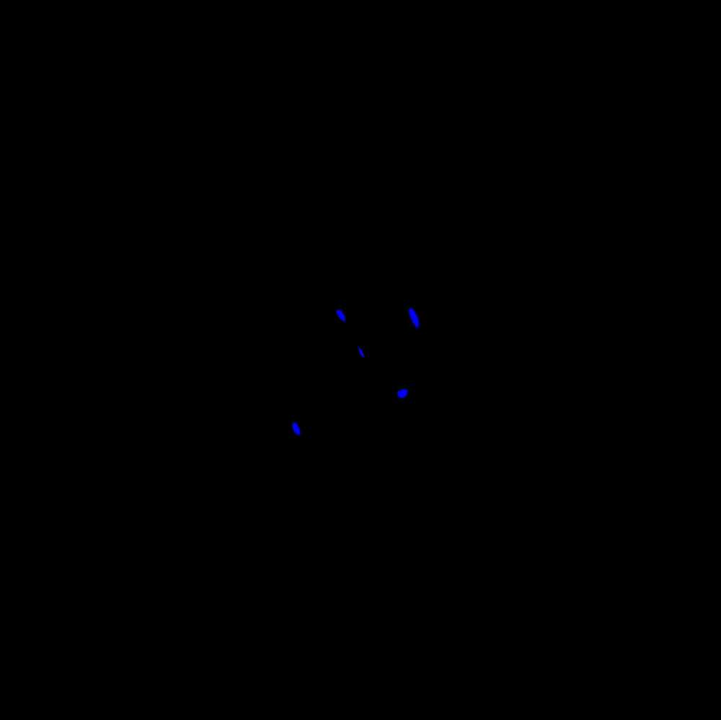
Lenstool: Shear effect
α​=90°
No Shear
Shear γ = 0,2
13

Slide 14
Lenstool: Shear effect
γ decrease with the distance
Shear is tangent to the potential
Potential
Distance
14

Slide 15
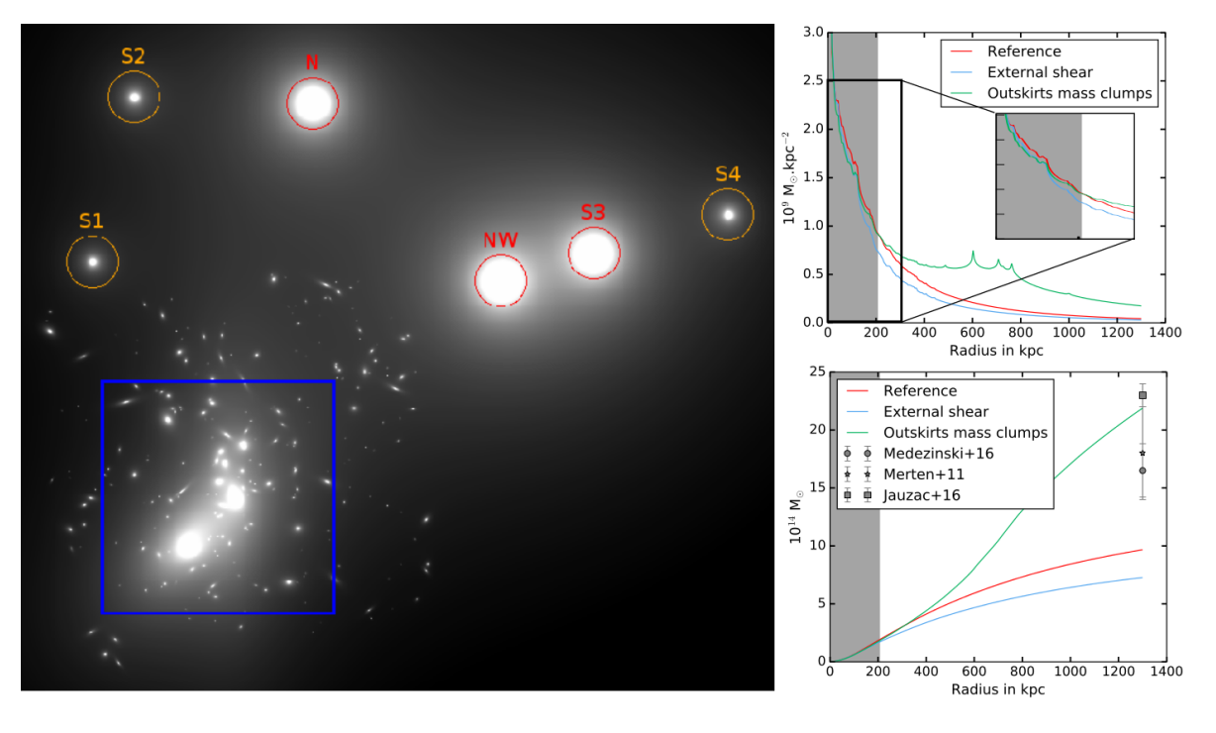
LENSTOOL: Scientific interest
G. Mahler et al 2018
15

Slide 16
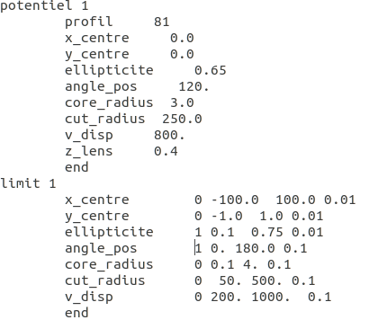
Lenstool: Potential optimisation
Prior : uniform, gaussian
Limit : min, max
Iteration step, deviation 1σ
Find images for each case and compute χ²
16

Slide 17
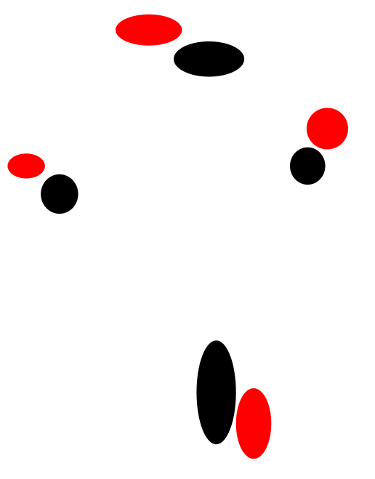
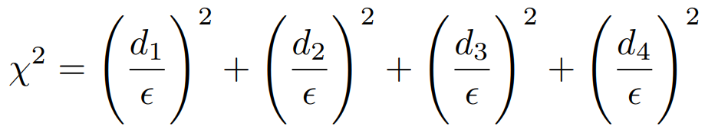
LENSTOOL: χ² CALCULATION
d1
d2
d3
Di : separation distance in arcsec
ε : astrometric errors (0.1'')
d4
Black : model
Red : images found
17

Slide 18
LensTOOL: Test procedure
INPUT
OPTIMIZATION
OUTPUT
Images with shear
1 potential optimizing
Θ,ellipticity,...
2 potentials :
1 fixed potential
1 spherical potential
optimizing: x, σ, y...
γ = 0​
Best model minimizing χ²
γ = 0,2
18

Slide 19

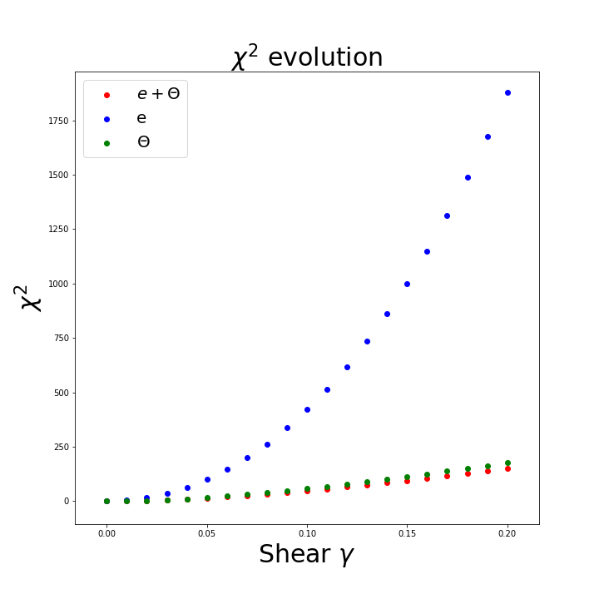
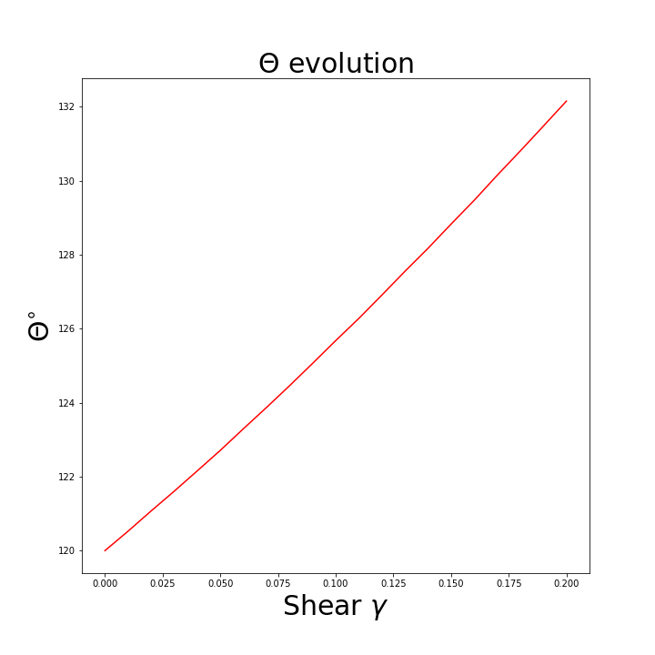
Lenstool: Results for 1 potential
19

Slide 20
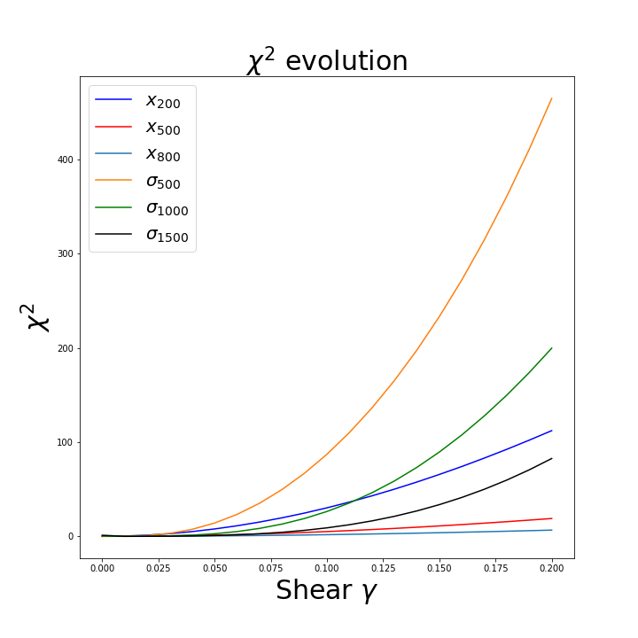
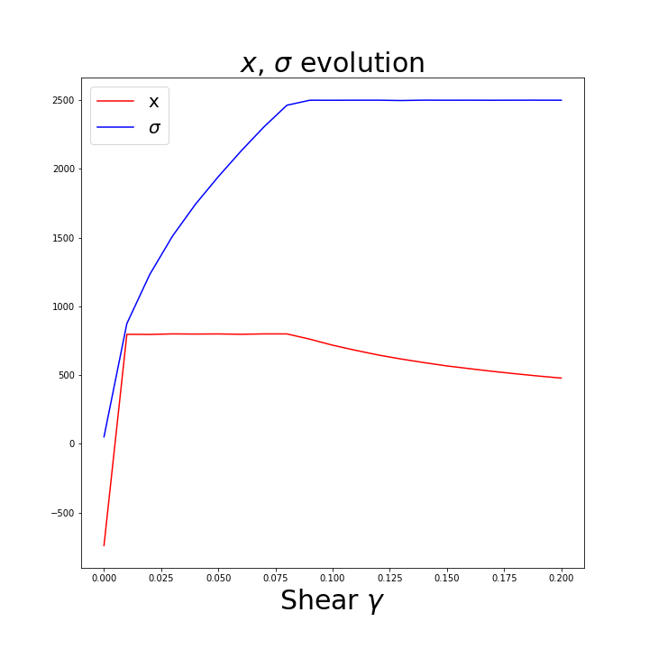
LENSTOOL: Results for 2 potentials
20

Slide 21
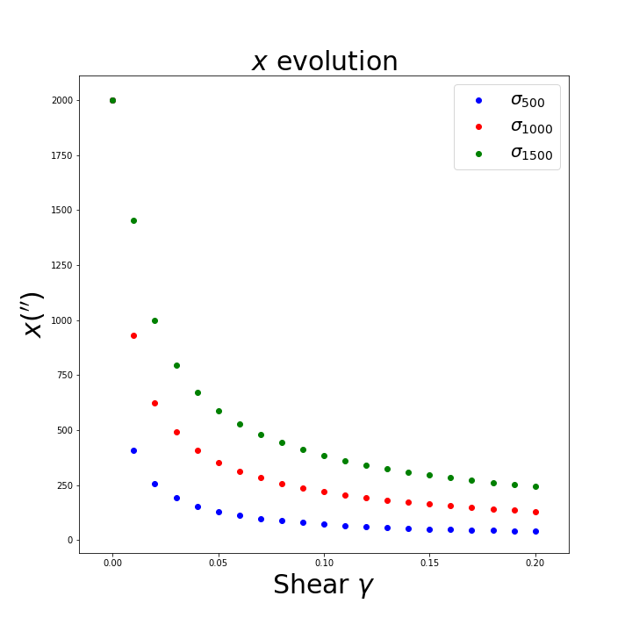
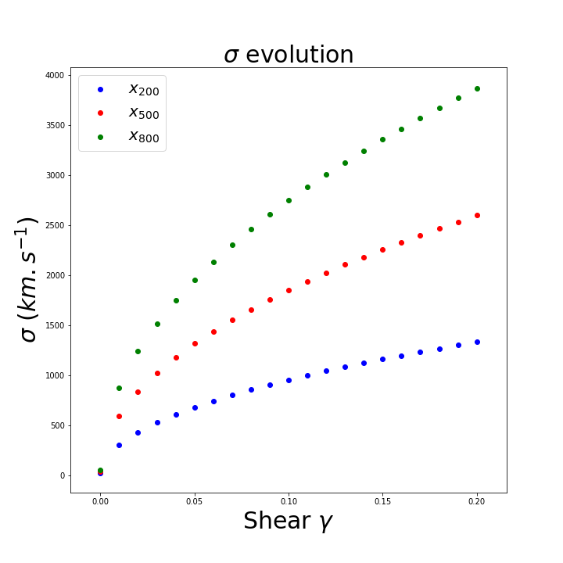
LENSTOOL: Results for 2 potentials
21

Slide 22
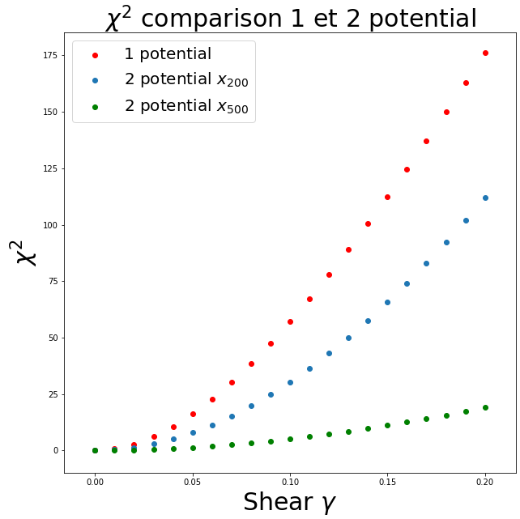
LENSTOOL: Results
Better results with 2 potentials
Model is harder to reproduce with increasing shear
22

Slide 23
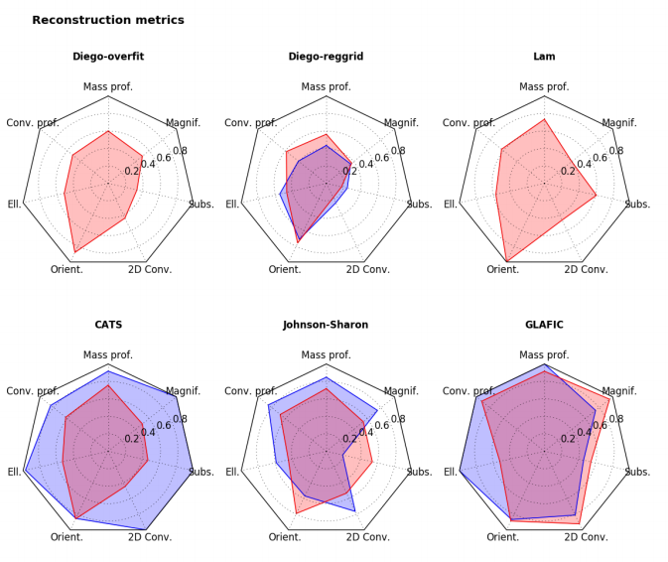
Lenstool: current limit + other models
Red : SPH model
Blue : Semi-analytical model
CATS uses LENSTOOL
Meneghetti et al 2017
23

Slide 24
Conclusion
Install C program with svn and compile with all libraries/dependencies
Understand and use a scientific program
Understand overall behaviour of the optimisation process for parametric model
Data Analysis with python
Visualisation with DS9
Shear is important to understand the environment effect
Good reproduction of images with shear when including a 2nd spherical potential
Considering mass environment what would be the effect on the images ?
Thank you !
24

